Slide 1




Data preperation and excel comparison
By maz

Slide 2
Introduction
Statistical programming languages are computer languages used to manipulate data and create statistical models. They are used in a variety of ways, from preparing data for analysis to creating complex models for predictive analytics. In this essay, we will explore the various ways in which statistical programming languages can be used in preparing data for analysis and within analysis projects. We will discuss the techniques of searching, sorting, grouping, filtering, modelling and how they can be used to prepare data for analysis. We will also compare the use of statistical programming languages with Excel and discuss how they could be used in a data analysis role.

Slide 3
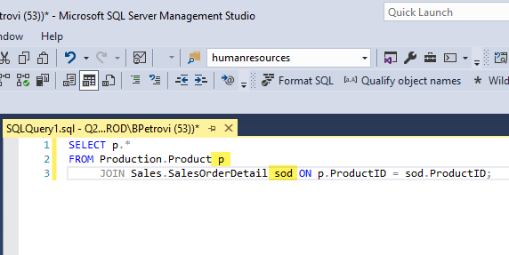
Searching
When it comes to putting together data for analysis, searching is a crucial strategy. Powerful search features offered by statistical programming languages enable users to easily find particular records or values within a dataset. For instance, the widely used language SQL (Structured Query Language) is used to search databases. It enables users to create searches that may sift through enormous datasets and only display the records that meet specific requirements. This eliminates the need to manually search through each record in a dataset to discover particular records or values.

Slide 4
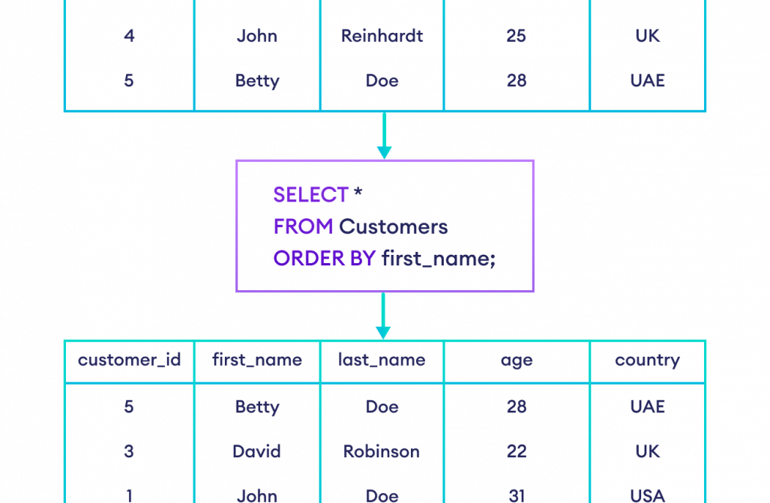
Sorting
Another crucial method for getting data ready for study is sorting. Powerful sorting features in statistical programming languages enable users to swiftly arrange their datasets into useful orderings. For instance, SQL has commands like ORDER BY that let users arrange their datasets in either ascending or descending order based on any number of columns or attributes. Large datasets can be swiftly arranged in this way into meaningful orderings that can be utilised for additional research or visualisation.

Slide 5

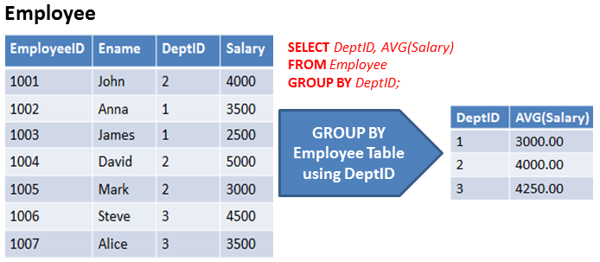
Grouping
Another helpful method for getting data ready for analysis is grouping. It is possible to swiftly divide datasets into useful categories or groups using the extensive grouping features that statistical computer languages offer. In order to extract useful categories or groups from a dataset, SQL, for instance, offers procedures like Classify BY that let users group their datasets by any number of columns or attributes. Large datasets can be quickly and easily arranged into useful categories or groups that can be utilised for additional research or visualisation.

Slide 6

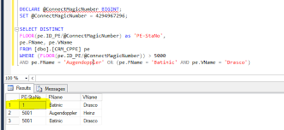
Filtering
Another vital method for getting data ready for analysis is filtering. Strong filtering features offered by statistical programming languages enable users to swiftly remove undesirable entries from their datasets in accordance with predefined criteria. To construct more concentrated subsets of the information that may then be utilised for additional analysis or visualisation, SQL, for instance, offers commands like WHERE that enable users to filter away undesired entries from their datasets based on any number of columns or fields. Modeling Another helpful method for getting data ready for analysis and building prediction models from the current dataset is modelling. With the help of powerful modelling capabilities offered by statistical programming languages, users can quickly build complex models from their datasets using a variety of algorithms and techniques, including decision trees, logistic regression, linear regression, and more sophisticated machine learning algorithms like neural networks and support vector machines (SVMs). Then, based on historical patterns in the relevant dataset, these models can be applied to predictive analytics tasks like anticipating future trends or customer behaviour.

Slide 7

Comparison with Excel
Due to its extensive use among business professionals and its capacity to handle significant volumes of data reliably and efficiently without requiring any coding skills from its user base, statistical programming languages are frequently compared to Excel. However, Excel's capabilities are limited in comparison to those provided by statistical programming languages like R and Python, despite having several fundamental statistical functions built-in (such as SUMIFS). When it comes to efficiently processing massive volumes of data, building sophisticated models, performing predictive analytics, etc., these languages offer considerably more powerful tools than Excel. Additionally, these products call for some coding expertise, which not all business people may possess. Therefore, those who need more sophisticated tools should think about utilising one of these statistical programming languages rather than Excel, even though Excel may still have a place among business professionals who need fundamental statistical operations.

Slide 8
How could you use them in a Data Analysis Role?
One would normally use statistical programming languages like R and Python on a daily basis in a data analysis profession. These languages have strong tools, which make them the best options when working with lots of complex data. They also provide a lot of versatility when it comes to transforming this data into insightful information. These languages could be used, for instance, to execute operations like searching through massive databases, sorting through mountains of data, putting like objects together, removing unnecessary records, and building intricate models using machine learning methods. An analyst would benefit greatly from completing all of these procedures in order to acquire important insights into the underlying trends within the dataset at hand, which would then be utilised to drive judgments on potential future tactics.

